Slide 1

Homework 5 Presentation
Group 2:
Shiyu FAN (Leo)
Runhai XU (James)
Zhaohang YAN (Martin)

Slide 2


Slide 3
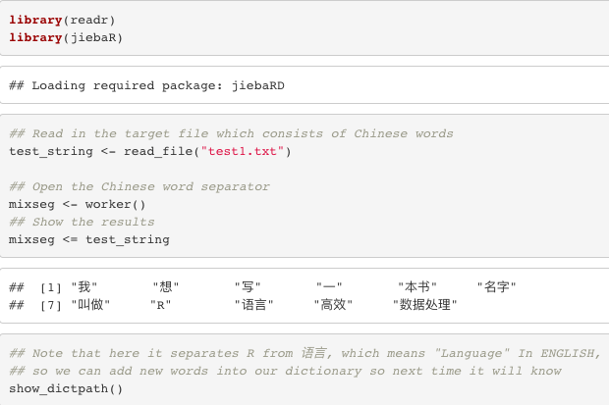

Slide 4

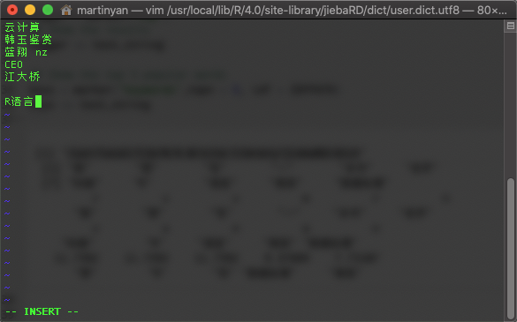
vim /usr/local/lib/R/4.0/site-library/jiebaRD/dict/user.dict.utf8

Slide 5
